Slide 1




Movie Recommendation System
Users face decision paralysis with overwhelming content libraries. The need for personalized suggestions is critical for engagement.
Load Datasets
Ratings.csv: userId, movieId, rating, timestamp
Ratings & Movies data
Movies.csv: movieId, title, genres
Utilizing PySpark MLlib's ALS for scalable recommendation engine. Parameters tuned for optimal performance:
Train ALS Model
Rank: 10
Collaborative Filtering
MaxIter: 10
RegParam: 0.1
ColdStartStrategy: 'drop'
Key Results
Evaluate
Measure RMSE accuracy
Achieved a robust RMSE of ~0.85, indicating high prediction accuracy.
Generate Recommendations
System generates personalized Top-10 movie recommendations for each user.
Top-N Movies

Slide 2
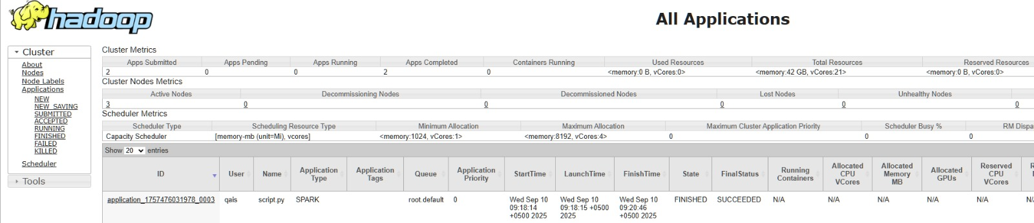
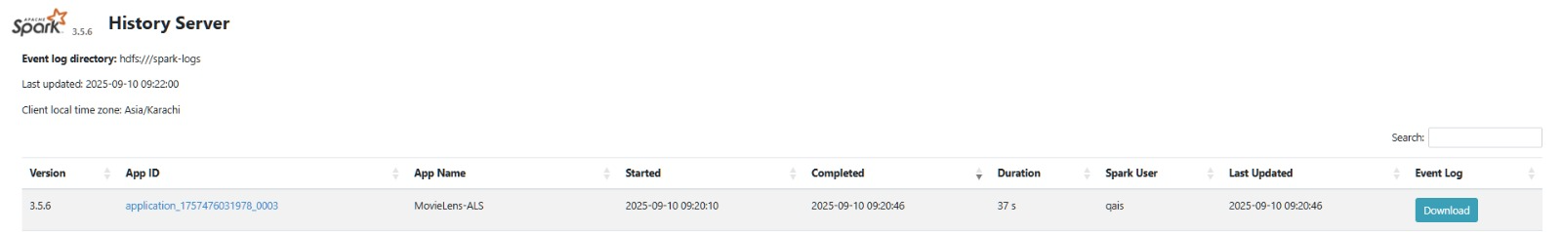
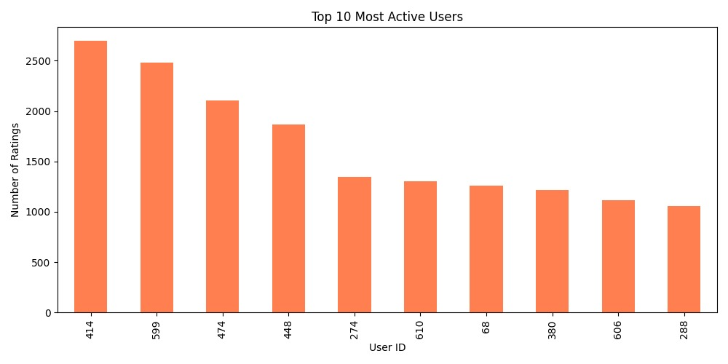
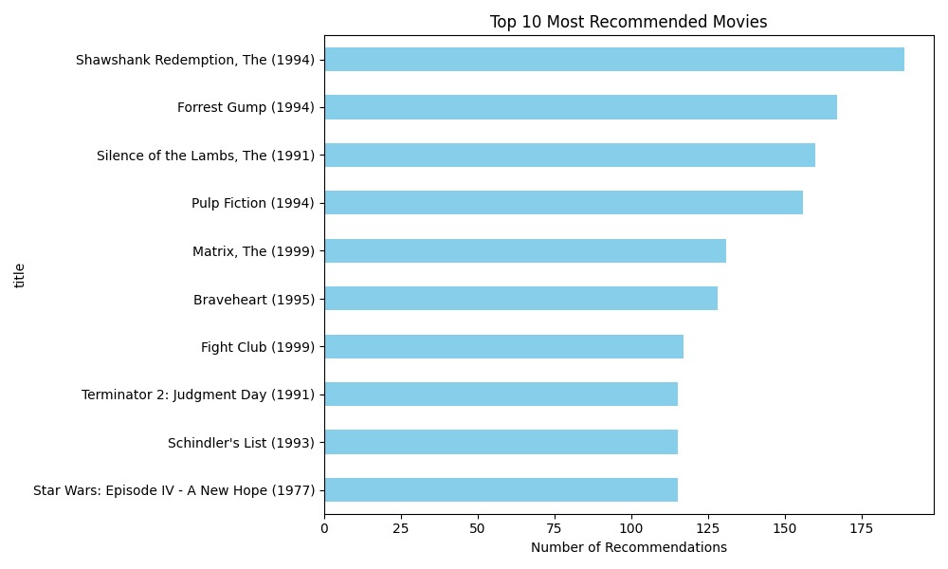
YARN
SPARK
Top 10 Active Users
Top 10 Recommended Movies

